Slide 1
Using Normalized Difference Vegetation Index (NDVI) to Monitor Cover Crops
Matthew Kutugata

Slide 2
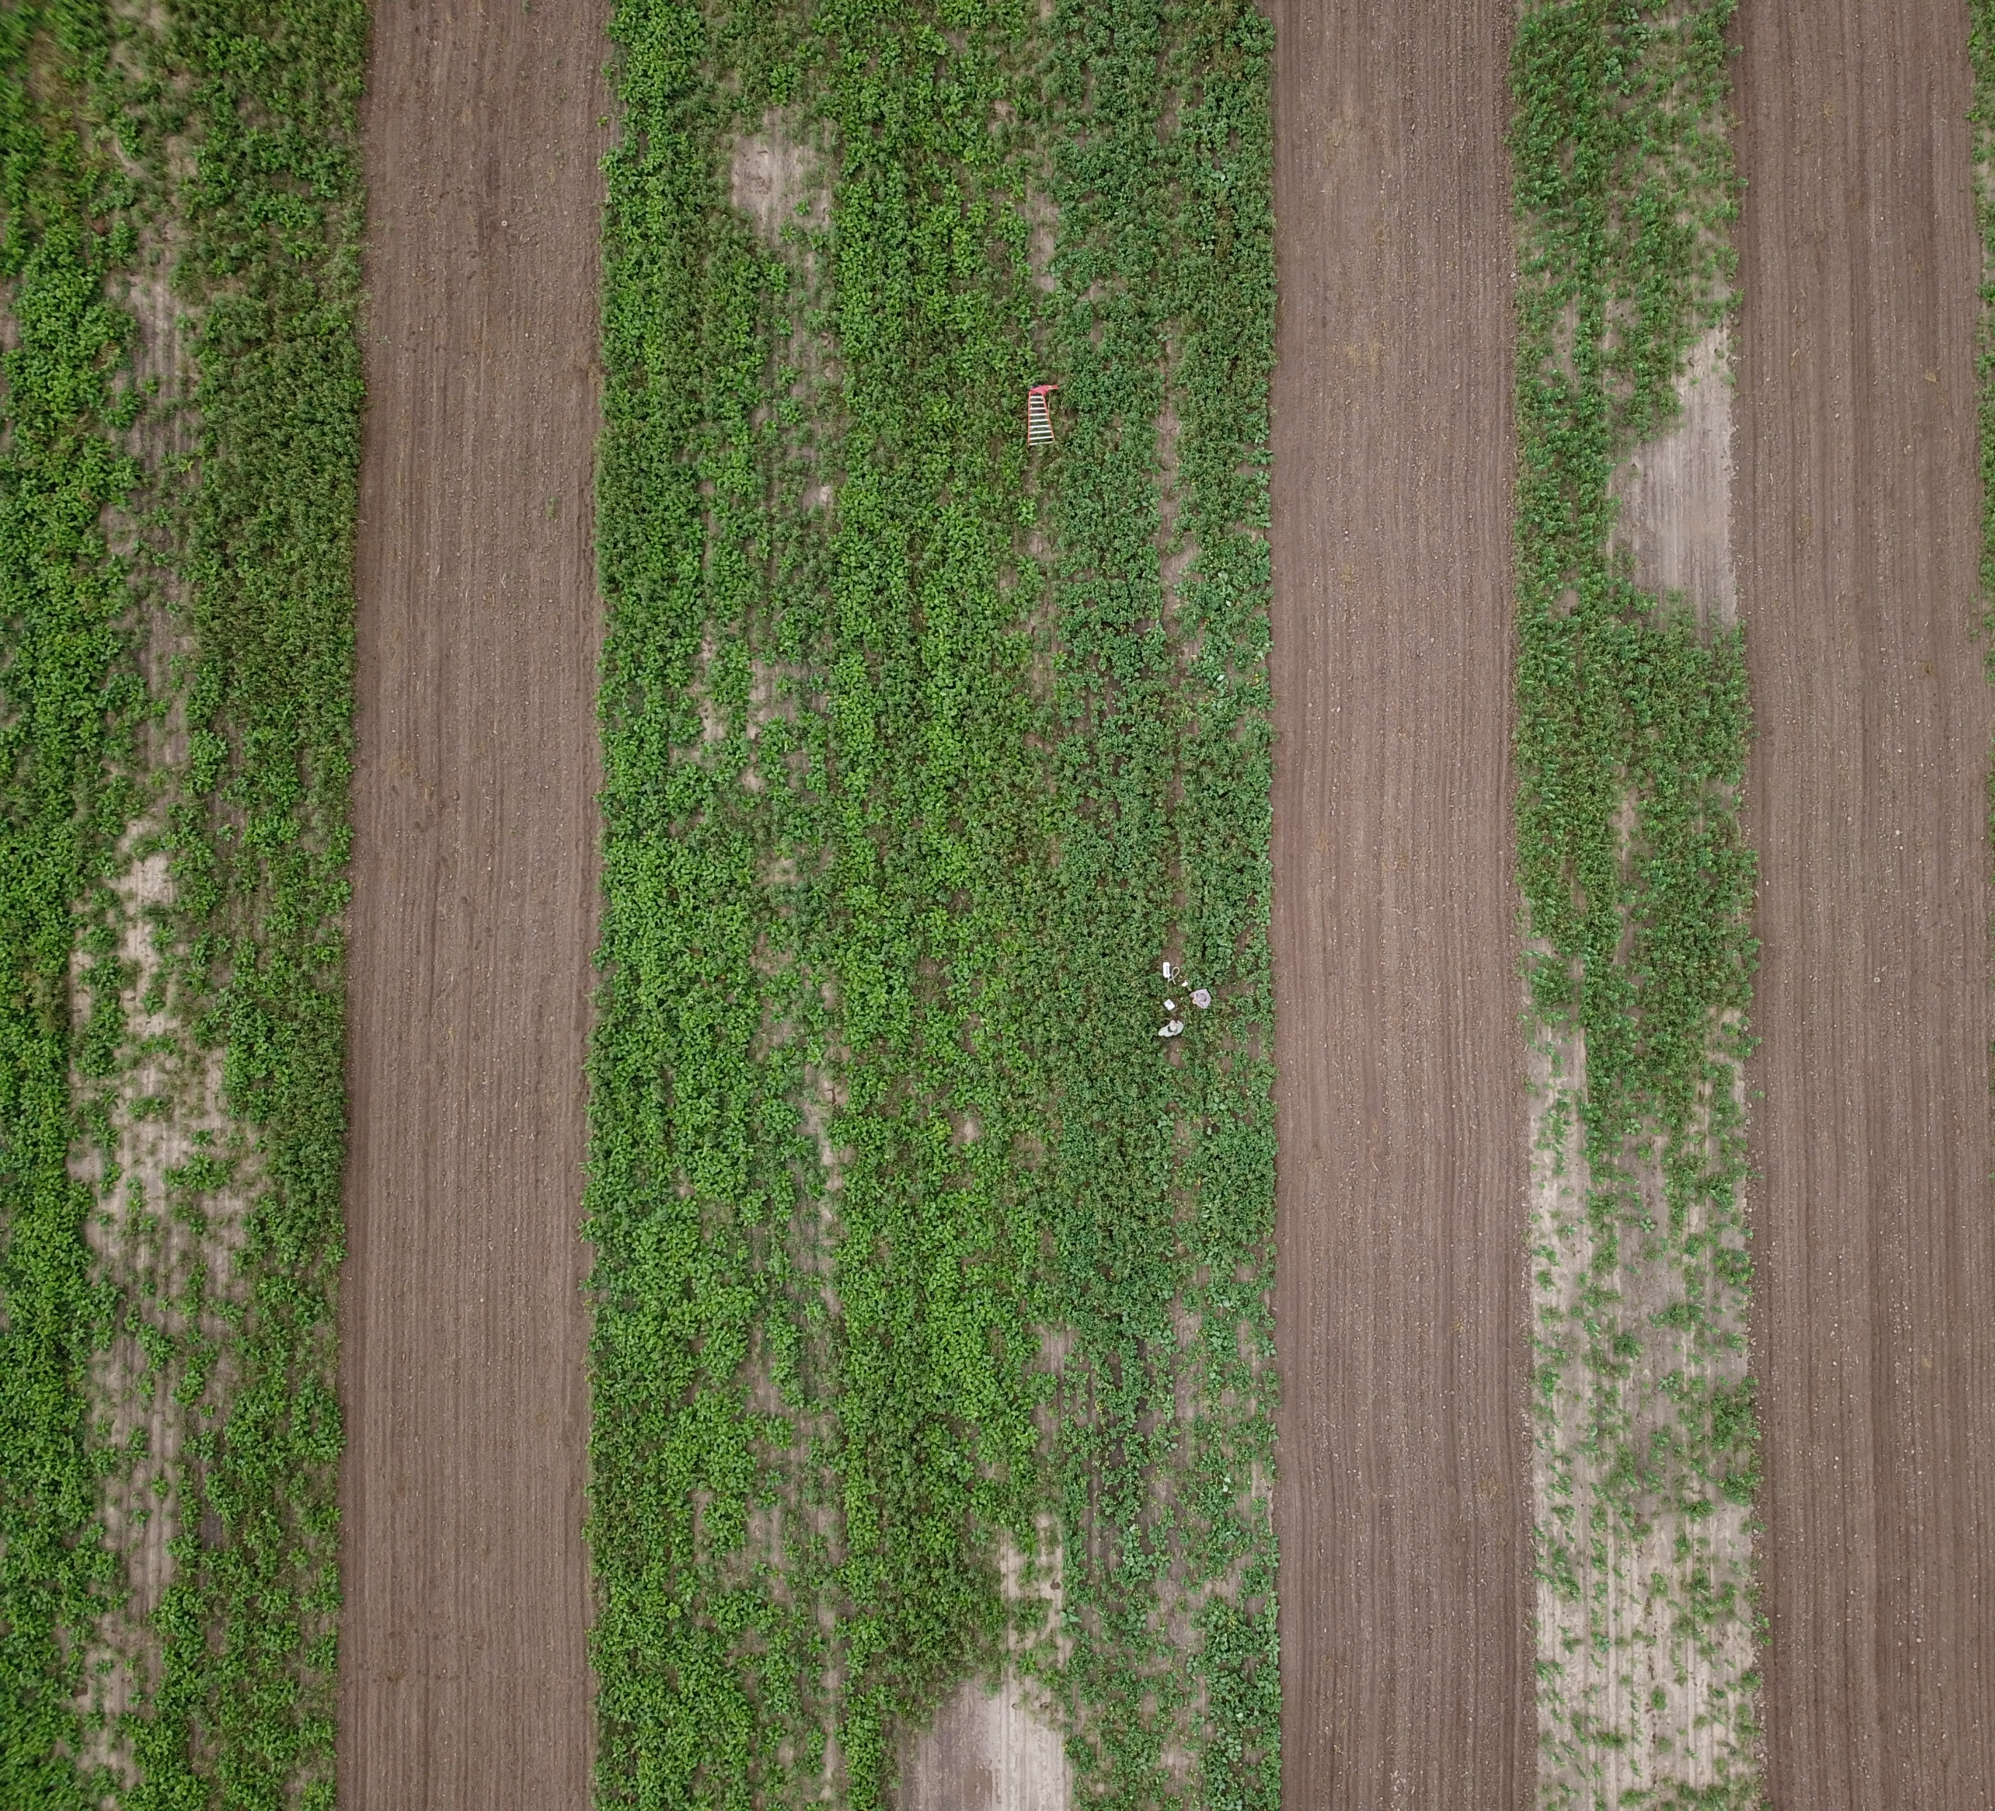
Cover crops research in the LRGV
Planted to control soil erosion, fertility, and quality; retain soil moisture; reduce weeds, pests, and disease; and improve biodiversity
Limited on-farm research of implementation practices (seeding rates, planting, termination, varieties)
Traditional quantitative sampling techniques over-simplify complex interactions
Remote sensing can help us understand field level interactions

Slide 3
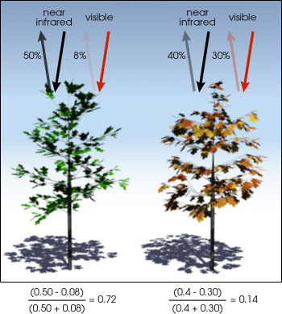

What is NDVI?
Quantifies vegetation by measuring the difference between near-infrared bands (which vegetation strongly reflects) and red bands (which vegetation absorbs).
-1 = water
1 = dense green vegetation
0 = no vegetation
$NDVI=\frac{Nir −Red}{Nir+Red}$
Photo: Israel Galindo, SARA, 2018
Nasa Earth Observatory, 2000
Nasa Earth Observatory, 2000

Slide 4
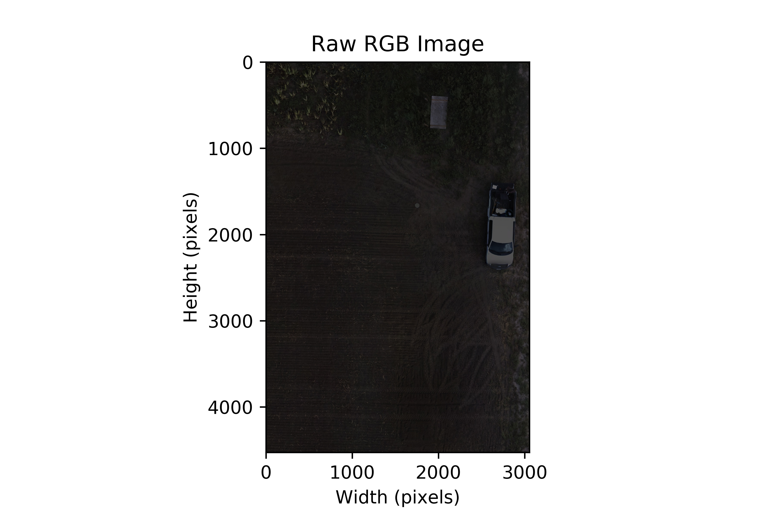
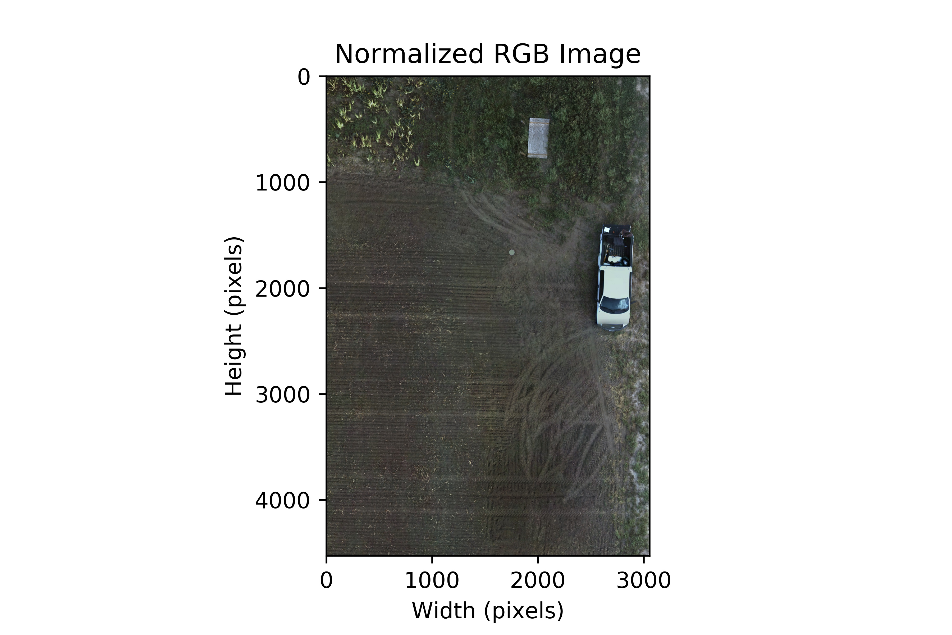
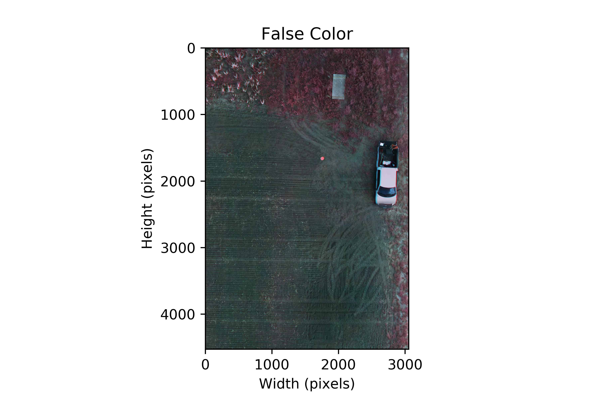
Pre-processing
Normalization
Visual Inspection (RGB and false color)

Slide 5
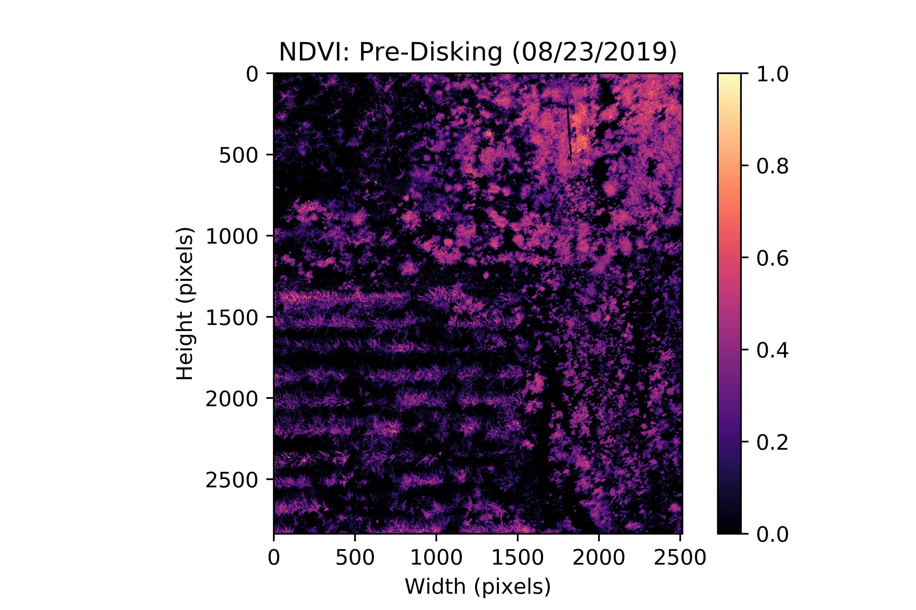
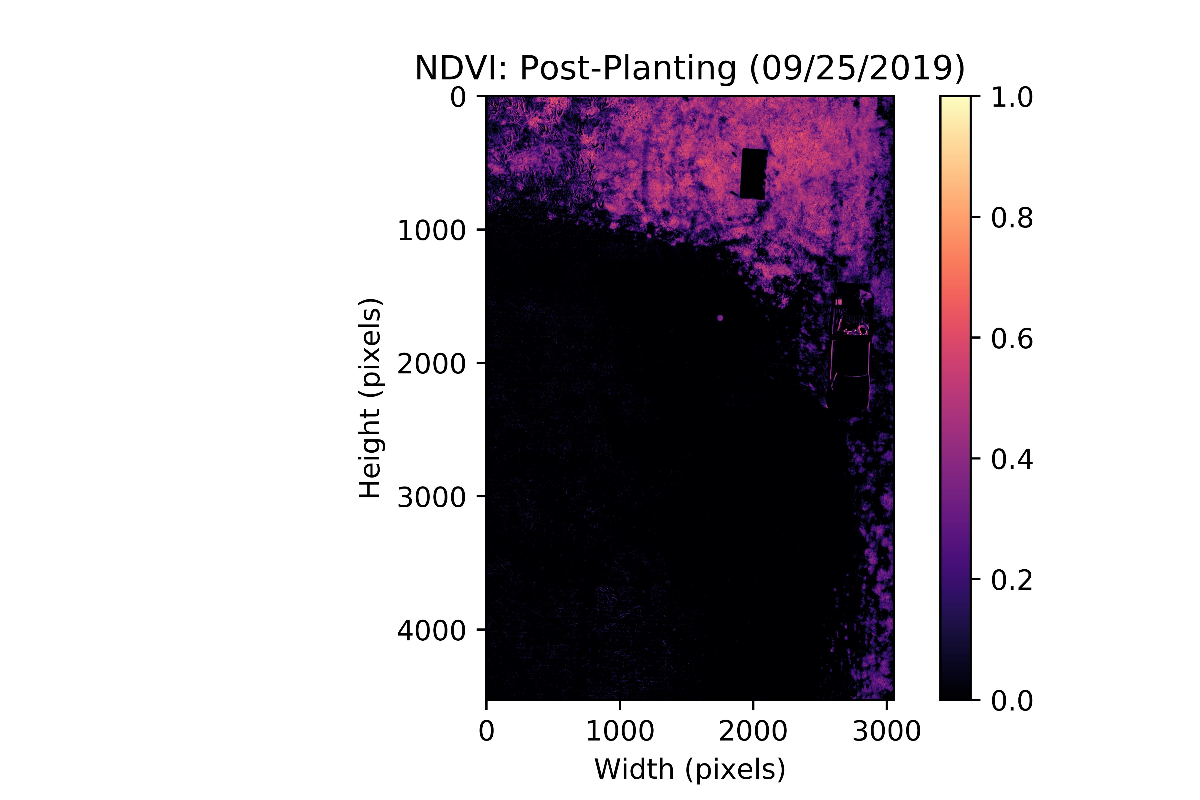
NDVI Calculation and Temporal Comparisons
Mean: 0.14543
Median: 0.07042
Mean: 0.08579
Median: 0.0

Slide 6
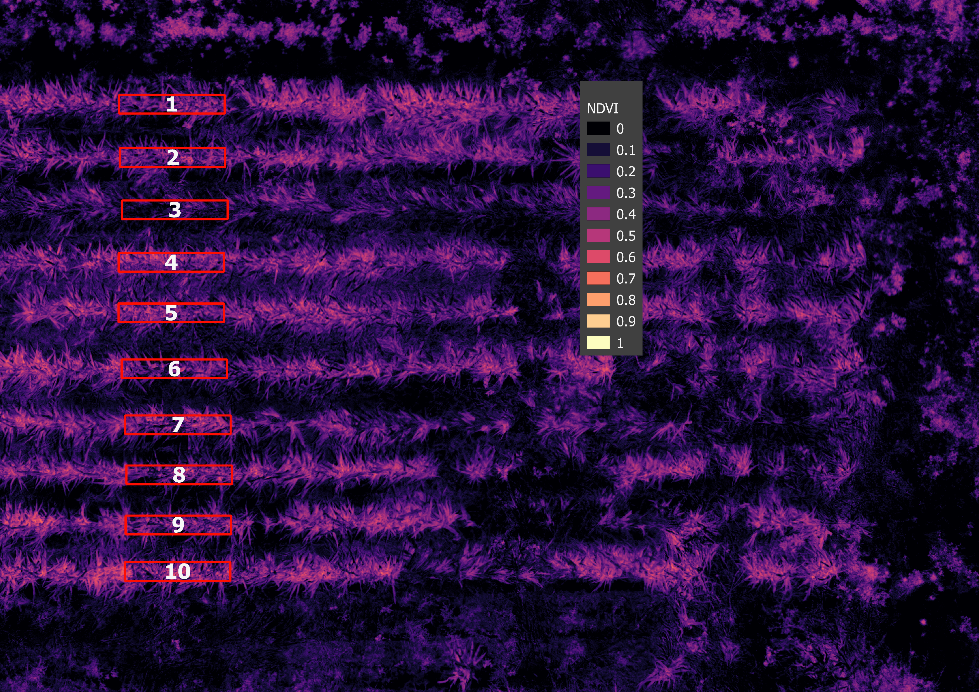
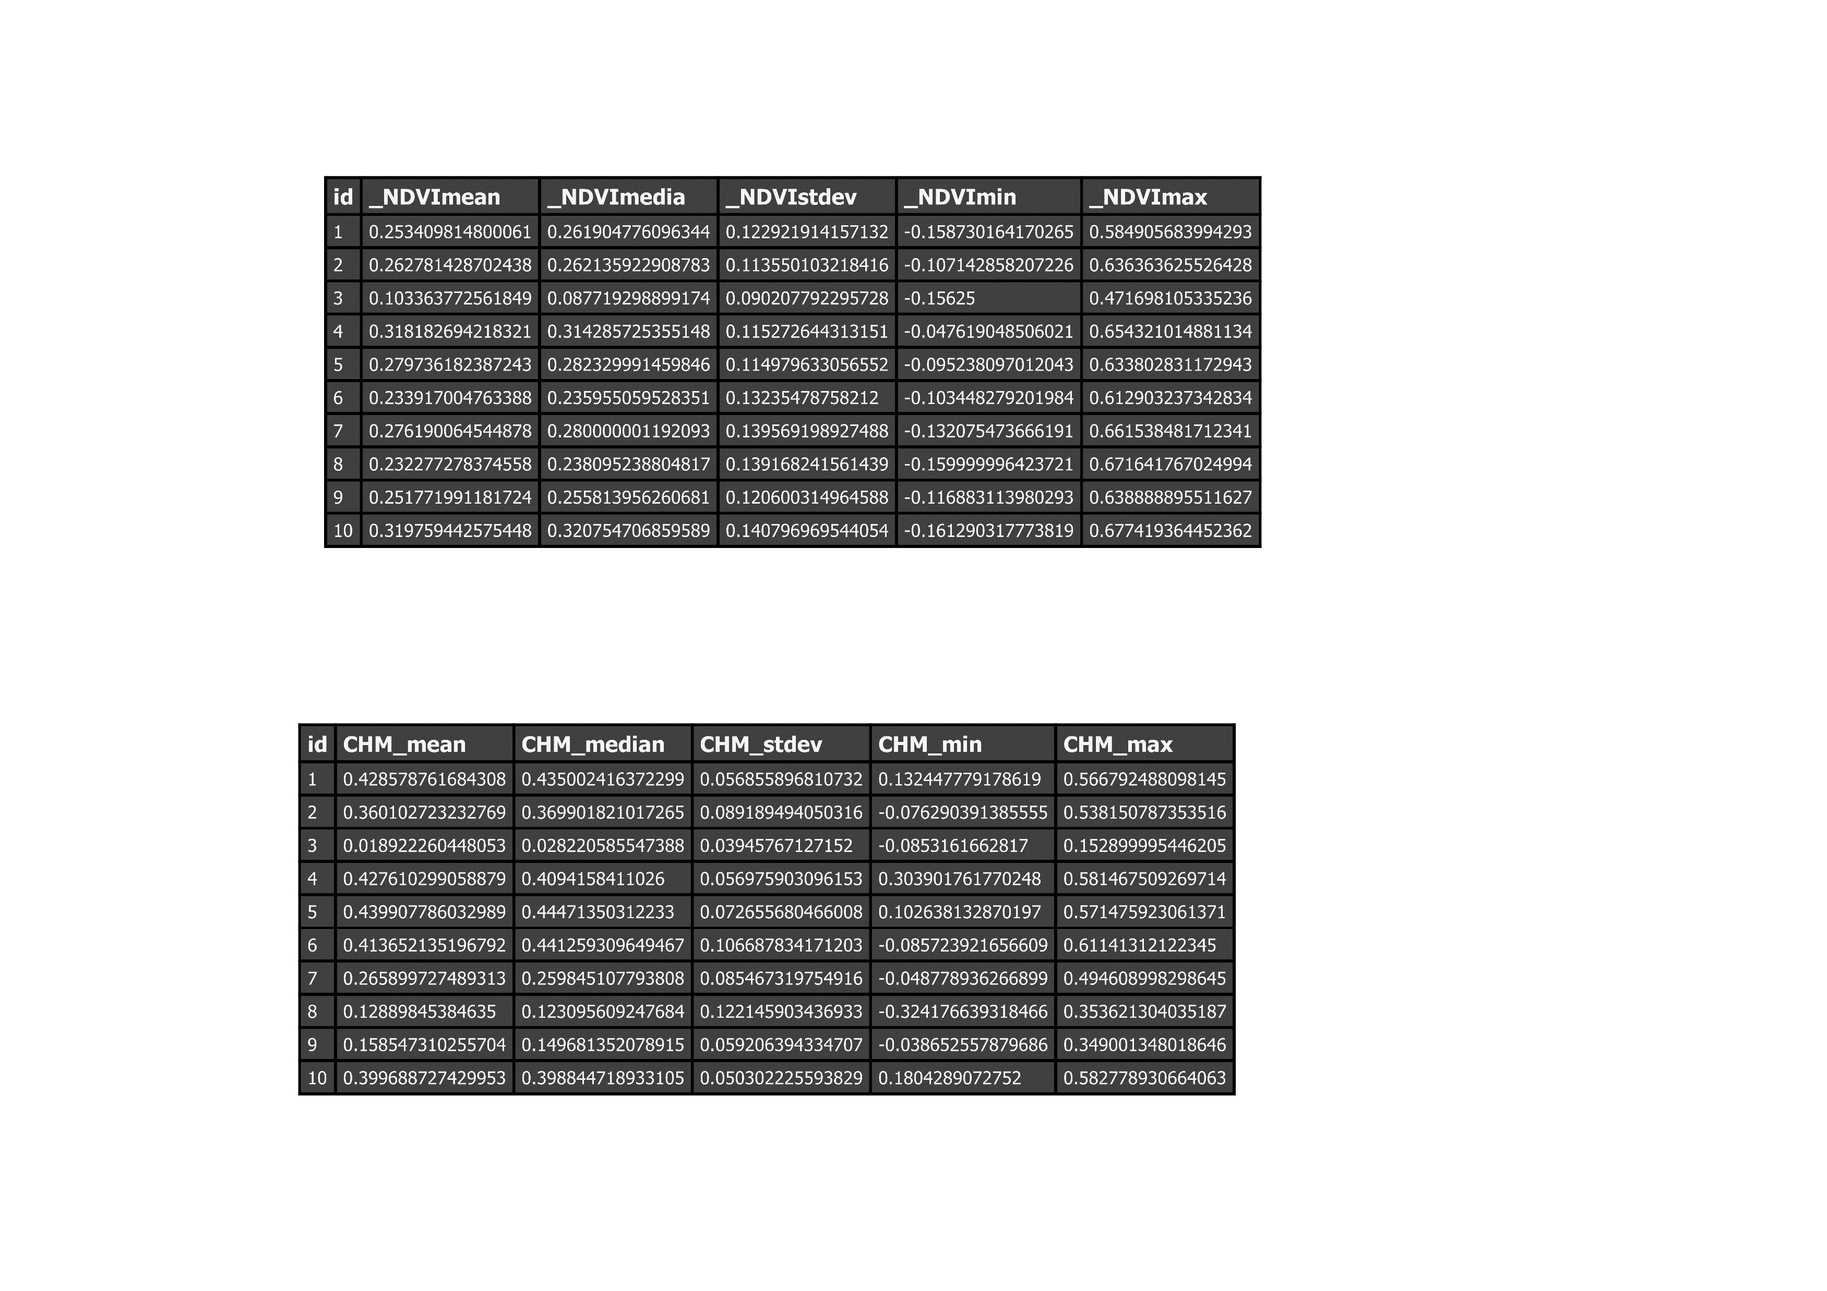
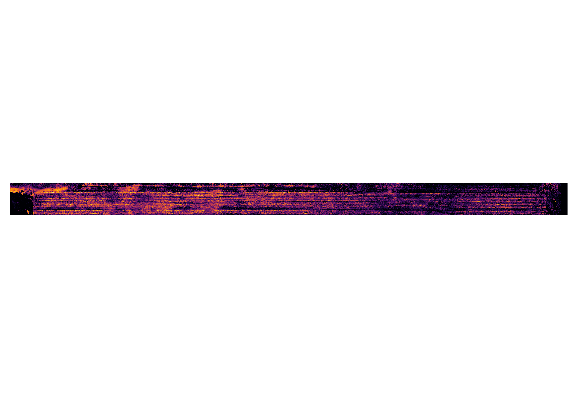
Future Work
Use georeferenced grid sampling areas to see changes in NDVI through time

